Slide 1
Divide-and-conquer
“United, we shall prevail; Divide, we shall perish”

Slide 2
5.1 Divide-and-conquer
Many useful algorithms are recursive in structure: to solve a given problem, they call themselves recursively one or more times to deal with closely related subproblems.
Divide-and-conquer approach: they break the problem into several subproblems that are similar to the original problem but smaller in size, solve the subproblems recursively, and then combine these solutions to create a solution to the original problem.

Slide 3
The divide-and-conquer paradigm involves three steps at each level of the recursion:
  Divide the problem into a number of subproblems.
  Conquer the subproblems by solving them recursively. If the subproblem sizes are small enough, however, just solve the subproblems in a straightforward manner.
  Combine the solutions to the subproblems into the solution for the original problem.

Slide 4
Analyzing divide-and-conquer algorithms
When an algorithm contains a recursive call to itself, its running time can often be described by a recurrence equation or recurrence, which describes the overall running time on a problem of size n in terms of the running time on smaller inputs. We can then use mathematical tools to solve the recurrence and provide bounds on the performance of the algorithm.
One advantage of divide-and-conquer algorithms is that their running times are often easily determined using techniques that will be introduced in section 6.

Slide 5
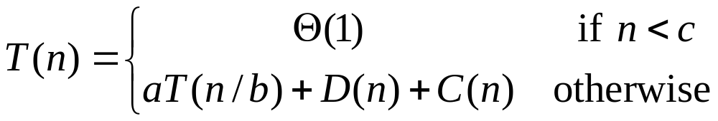
A recurrence for the running time of a divide-and-conquer algorithm is based on the three steps of the basic paradigm. As before, we let T (n) be the running time on a problem of size n. If the problem size is small enough, say n ≤ c for some constant c, the straightforward solution takes constant time, which we write as Θ(1). Suppose that our division of the problem yields a subproblems, each of which is 1/b the size of the original. If we take D(n) time to divide the problem into subproblems and C(n) time to combine the solutions to the subproblems into the solution to the original problem, we get the recurrence

Slide 6
5.2 Merge sort for the sorting problem
The basic steps of the merge sort algorithm:
  Divide the n-element sequence to be sorted into two subsequences of n/2 elements each.
  Sort the two subsequences recursively using merge sort.
  Merge the two sorted subsequences to produce the sorted answer.

Slide 7
Merge algorithm
The key operation of the merge sort algorithm is the merging of two sorted sequences in the "combine" step. To perform the merging, we use an auxiliary procedure Merge(A, p, q, r), where A is an array and p, q, and r are indices numbering elements of the array such that p ≤ q< r. The procedure assumes that the subarrays A[p..q] and A[q + 1..r] are in sorted order. It merges them to form a single sorted subarray that replaces the current subarray A[p..r].

Slide 8
Merge program
Merge(A, p, q, r)
1 n₁←q-p+1
2 n₂←r-q
3 for i←1 to n₁ do
4 L[i]←A[p+i-1]
5 for j←1 to n₂ do
6 R[j]←A[q + j]
7 L[n₁+1]←∞
8 R[n₂+1]←∞
9 i←1
10 j←1
11 for k ← p to r do
12 if L[i]≤R[j] then
13 A[k] ← L[i]
14 i ← i + 1
15 else A[k] ← R[j]
16 j ← j + 1

Slide 9
∞
∞
13
57
11
45
L
7
R
2
6
3
2
3
6
7
11
13
45
57
A

Slide 10
The correctness of merge procedure
The loop invariant (循环不变量):
At the start of each iteration of the for loop of lines 12-17, the subarray A[p..k - 1] contains the k - p smallest elements of L[1..n₁ + 1] and R[1..n₂ + 1], in sorted order. Moreover, L[i] and R[j] are the smallest elements of their arrays that have not been copied back into A.
We must show that this loop invariant holds prior to the first iteration of the for loop of lines 12-17, that each iteration of the loop maintains the invariant, and that the invariant provides a useful property to show correctness when the loop terminates.

Slide 11
Initialization:
Prior to the first iteration of the loop, we have k = p, so that the subarray A[p..k - 1] is empty. This empty subarray contains the k - p = 0 smallest elements of L and R, and since i = j = 1, both L[i] and R[j] are the smallest elements of their arrays that have not been copied back into A.

Slide 12
Maintenance:
To see that each iteration maintains the loop invariant, let us first suppose that L[i] ≤ R[j]. Then L[i] is the smallest element not yet copied back into A. Because A[p..k - 1] contains the k - p smallest elements, after line 14 copies L[i] into A[k], the subarray A[p..k] will contain the k - p + 1 smallest elements. Incrementing k (in the for loop update) and i (in line 15) reestablishes the loop invariant for the next iteration. If instead L[i] > R[j], then lines 16-17 perform the appropriate action to maintain the loop invariant.

Slide 13
Termination:
At termination, k = r + 1. By the loop invariant, the subarray A[p..k -1], which is A[p..r], contains the k - p = r - p + 1 smallest elements of L[1..n₁ + 1] and R[1..n₂ + 1], in sorted order. The arrays L and R together contain n₁ + n₂ + 2 = r- p + 3 elements. All but the two largest have been copied back into A, and these two largest elements are the sentinels.

Slide 14
Merge sort procedure
Use the Merge procedure as a subroutine, we can obtain the merge sort procedure.
MergeSort(A, p, r)
1 if p < r then
2 q ← ⌊(p + r)/2⌋
3 MergeSort(A, p, q)
4 MergeSort(A, q + 1, r)
5 Merge(A, p, q, r)
Call MergeSort (A, 1, length[A]) for the sorting problem.

Slide 15
Execution Example
Partition
7 2 9 4 ⏐ 3 8 6 1 → 1 2 3 4 6 7 8 9
7 2 9 4 → 2 4 7 9
3 8 6 1 → 1 3 8 6
7 2 → 2 7
9 4 → 4 9
3 8 → 3 8
6 1 → 1 6
7 → 7
2 → 2
9 → 9
4 → 4
3 → 3
8 → 8
6 → 6
1 → 1

Slide 16
Execution Example (cont.)
Recursive call, partition
7 2 9 4 ⏐ 3 8 6 1 → 1 2 3 4 6 7 8 9
7 2 ⏐ 9 4 → 2 4 7 9
3 8 6 1 → 1 3 8 6
7 2 → 2 7
9 4 → 4 9
3 8 → 3 8
6 1 → 1 6
7 → 7
2 → 2
9 → 9
4 → 4
3 → 3
8 → 8
6 → 6
1 → 1

Slide 17
Execution Example (cont.)
Recursive call, partition
7 2 9 4 ⏐ 3 8 6 1 → 1 2 3 4 6 7 8 9
7 2 ⏐ 9 4 → 2 4 7 9
3 8 6 1 → 1 3 8 6
7 ⏐ 2 → 2 7
9 4 → 4 9
3 8 → 3 8
6 1 → 1 6
7 → 7
2 → 2
9 → 9
4 → 4
3 → 3
8 → 8
6 → 6
1 → 1

Slide 18
Execution Example (cont.)
Recursive call, base case
7 2 9 4 ⏐ 3 8 6 1 → 1 2 3 4 6 7 8 9
7 2 ⏐ 9 4 → 2 4 7 9
3 8 6 1 → 1 3 8 6
7 ⏐ 2 → 2 7
9 4 → 4 9
3 8 → 3 8
6 1 → 1 6
7 → 7
2 → 2
9 → 9
4 → 4
3 → 3
8 → 8
6 → 6
1 → 1

Slide 19
Execution Example (cont.)
Recursive call, base case
7 2 9 4 ⏐ 3 8 6 1 → 1 2 3 4 6 7 8 9
7 2 ⏐ 9 4 → 2 4 7 9
3 8 6 1 → 1 3 8 6
7 ⏐ 2 → 2 7
9 4 → 4 9
3 8 → 3 8
6 1 → 1 6
7 → 7
2 → 2
9 → 9
4 → 4
3 → 3
8 → 8
6 → 6
1 → 1

Slide 20
Execution Example (cont.)
Merge
7 2 9 4 ⏐ 3 8 6 1 → 1 2 3 4 6 7 8 9
7 2 ⏐ 9 4 → 2 4 7 9
3 8 6 1 → 1 3 8 6
7 ⏐ 2 → 2 7
9 4 → 4 9
3 8 → 3 8
6 1 → 1 6
7 → 7
2 → 2
9 → 9
4 → 4
3 → 3
8 → 8
6 → 6
1 → 1

Slide 21
Execution Example (cont.)
Recursive call, …, base case, merge
7 2 9 4 ⏐ 3 8 6 1 → 1 2 3 4 6 7 8 9
7 2 ⏐ 9 4 → 2 4 7 9
3 8 6 1 → 1 3 8 6
7 ⏐ 2 → 2 7
9 4 → 4 9
3 8 → 3 8
6 1 → 1 6
7 → 7
2 → 2
9 → 9
4 → 4
3 → 3
8 → 8
6 → 6
1 → 1

Slide 22
Execution Example (cont.)
Merge
7 2 9 4 ⏐ 3 8 6 1 → 1 2 3 4 6 7 8 9
7 2 ⏐ 9 4 → 2 4 7 9
3 8 6 1 → 1 3 8 6
7 ⏐ 2 → 2 7
9 4 → 4 9
3 8 → 3 8
6 1 → 1 6
7 → 7
2 → 2
9 → 9
4 → 4
3 → 3
8 → 8
6 → 6
1 → 1

Slide 23
Execution Example (cont.)
Recursive call, …, merge, merge
7 2 9 4 ⏐ 3 8 6 1 → 1 2 3 4 6 7 8 9
7 2 ⏐ 9 4 → 2 4 7 9
3 8 6 1 → 1 3 6 8
7 ⏐ 2 → 2 7
9 4 → 4 9
3 8 → 3 8
6 1 → 1 6
7 → 7
2 → 2
9 → 9
4 → 4
3 → 3
8 → 8
6 → 6
1 → 1

Slide 24
Execution Example (cont.)
Merge
7 2 9 4 ⏐ 3 8 6 1 → 1 2 3 4 6 7 8 9
7 2 ⏐ 9 4 → 2 4 7 9
3 8 6 1 → 1 3 6 8
7 ⏐ 2 → 2 7
9 4 → 4 9
3 8 → 3 8
6 1 → 1 6
7 → 7
2 → 2
9 → 9
4 → 4
3 → 3
8 → 8
6 → 6
1 → 1

Slide 25
Analysis of merge sort
Recurrence equation
Describes the overall running time on a problem of size n in terms of the running time on smaller inputs.
Let T(n) be the running time on a problem of size n. When we have n > 1 elements, we break down the running time as follows.
  D(n): the running time of computing the middle of the subarray in the divide step, which takes constant time c₁.
  Recursively solve two subproblems, each of size n/2, which contributes 2T (n/2) to the running time.
  C(n): the running time of MERGE in merge step, which takes time c₂n.

Slide 26
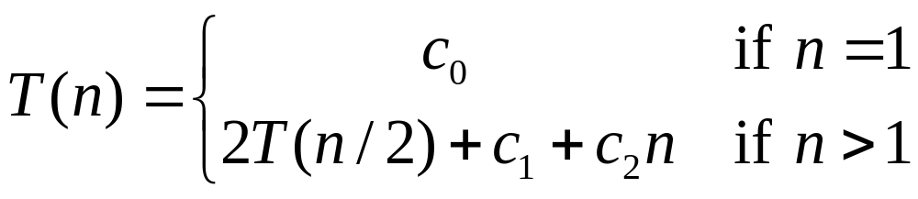
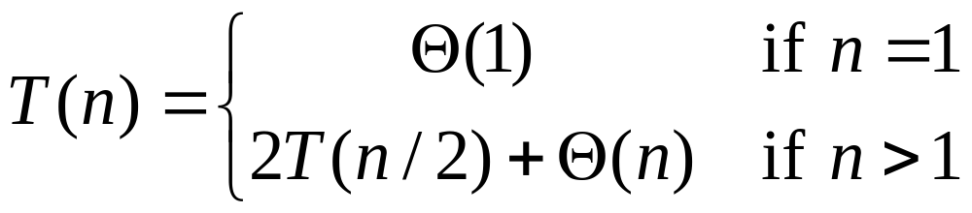
So the recurrence for the worst-case running time T (n) of merge sort is given as follows:
Let us rewrite the above recurrence as
Make use of master theorem, we obtain O(nlgn)

Slide 27
5.3 Description of quicksort
Quicksort is based on the divide-and-conquer paradigm
Divide: Partition (rearrange) the array A[p..r] into two (possibly empty) subarrays A[p..q - 1] and A[q + 1..r] such that each element of A[p..q - 1] is less than or equal to A[q], which is, in turn, less than or equal to each element of A[q + 1..r]. Compute the index q as part of this partitioning procedure.
Conquer: Sort the two subarrays A[p..q -1] and A[q +1..r] by recursive calls to quicksort.
Combine: Since the subarrays are sorted in place, no work is needed to combine them: the entire array A[p..r] is now sorted.

Slide 28
Description of quicksort
QuickSort(A,p,r)
1 if p < r then
2 q← Partition(A, p, r)
3 QuickSort(A, p, q - 1)
4 QuickSort (A, q + 1, r)
QuickSort(A, 1, length[A])

Slide 29
Partitioning the array
Partition(A, p, r)
1 x ← A[r]
2 i ← p - 1
3 for j ← p to r – 1 do
4 if A[j] ≤ x then
5 i ← i + 1
6 A[i] ↔ A[j]
7 A[i + 1] ↔ A[r]
8 return i + 1

Slide 30
Partitioning
p
i
j
r
i
p, j
r
2
1
7
8
3
5
6
4
2
8
7
1
3
5
6
4
p
i
j
r
p, i
j
r
2
1
3
8
7
5
6
4
2
8
7
1
3
5
6
4
p
i
j
r
r
2
1
3
8
7
5
6
4
p, i
j
2
8
7
1
3
5
6
4
p
i
r
2
1
3
8
7
5
6
4
p, i
j
r
p
q-1
q
q+1
r
2
8
7
1
3
5
6
4
2
1
3
4
7
5
6
8

Slide 31
Execution Example
Randomized Pivot selection
7 2 9 4 3 7 6 1 → 1 2 3 4 6 7 8 9
7 2 9 4 → 2 4 7 9
3 8 6 1 → 1 3 8 6
2 → 2
9 4 → 4 9
3 → 3
8 → 8
9 → 9
4 → 4

Slide 32
Execution Example (cont.)
Partition, recursive call, pivot selection
7 2 9 4 3 7 6 1 → 1 2 3 4 6 7 8 9
2 4 3 1 → 2 4 7 9
3 8 6 1 → 1 3 8 6
2 → 2
9 4 → 4 9
3 → 3
8 → 8
9 → 9
4 → 4

Slide 33
Execution Example (cont.)
Partition, recursive call, base case
7 2 9 4 3 7 6 1 → → 1 2 3 4 6 7 8 9
2 4 3 1 →→ 2 4 7
3 8 6 1 → 1 3 8 6
1 → 1
9 4 → 4 9
3 → 3
8 → 8
9 → 9
4 → 4

Slide 34
Execution Example (cont.)
Recursive call, …, base case, join
7 2 9 4 3 7 6 1 → 1 2 3 4 6 7 8 9
2 4 3 1 → 1 2 3 4
3 8 6 1 → 1 3 8 6
1 → 1
4 3 → 3 4
3 → 3
8 → 8
9 → 9
4 → 4

Slide 35
Execution Example (cont.)
Recursive call, pivot selection
7 2 9 4 3 7 6 1 → 1 2 3 4 6 7 8 9
2 4 3 1 → 1 2 3 4
7 9 7 1 → 1 3 8 6
1 → 1
4 3 → 3 4
8 → 8
9 → 9
9 → 9
4 → 4

Slide 36
Execution Example (cont.)
Partition, …, recursive call, base case
7 2 9 4 3 7 6 1 → 1 2 3 4 6 7 8 9
2 4 3 1 → 1 2 3 4
7 9 7 1 → 1 3 8 6
1 → 1
4 3 → 3 4
8 → 8
9 → 9
9 → 9
4 → 4

Slide 37
Execution Example (cont.)
Join, join
7 2 9 4 3 7 6 1 → 1 2 3 4 6 7 7 9
2 4 3 1 → 1 2 3 4
7 9 7 → 17 7 9
1 → 1
4 3 → 3 4
8 → 8
9 → 9
9 → 9
4 → 4

Slide 38
Performance of quicksort
Worst-case partitioning
The worst-case behavior for QuickSort occurs when the partitioning routine produces one subproblem with n - 1 elements and one with 0 elements.
T(n) = T(n - 1) + Θ(n).
Making use of the recursive tree method
T(n) = T(n - 1) + Θ(n)
= T(n - 2) + Θ(n)+ Θ(n-1)
= …
= Θ(n²)

Slide 39
Best-case partitioning
In the most even possible split, Partition produces two subproblems, each of size no more than n/2, since one is of size ⌊n/2⌋ and one of size ⌈n/2⌉- 1. In this case, quicksort runs much faster. The recurrence for the running time is then
T(n) = 2T(n/2) + Θ(n)
make use of the master method, we can obtain
T(n) = O(nlgn)

Slide 40
Average case behavior
For simplicity, we assume that the input elements are distinct. In order to simplify the analysis further, we will
assume that every permutation of the elements is equally likely. This ensures that each number in the array is equally likely to be chosen as the pivot, i.e., the probability that any element of A will be picked as the pivot is 1/n.
Let T(n) denote the number of average comparisons done by QuickSort. When an element is chosen as the pivot, the number of comparisons done by Partition is n-1

Slide 41
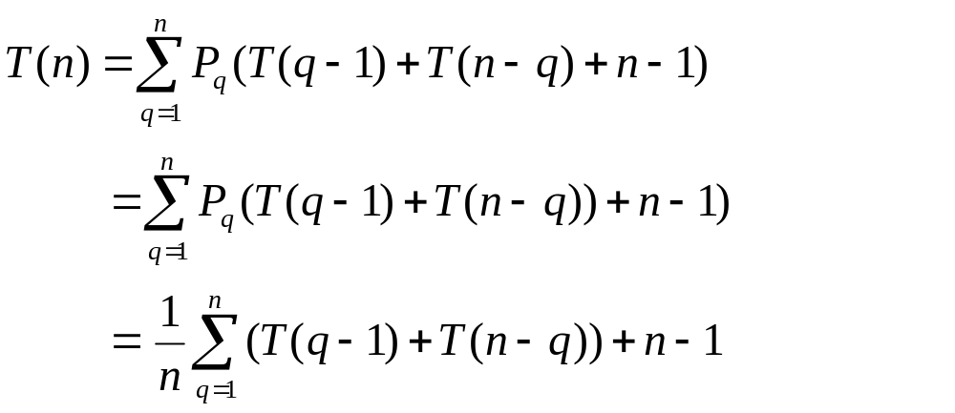
So,

Slide 42
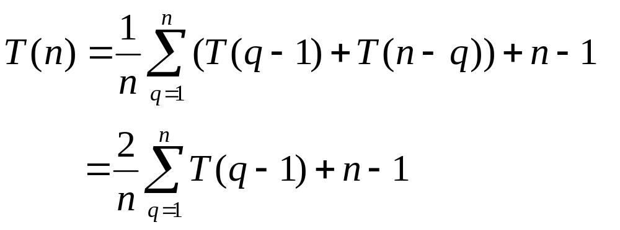
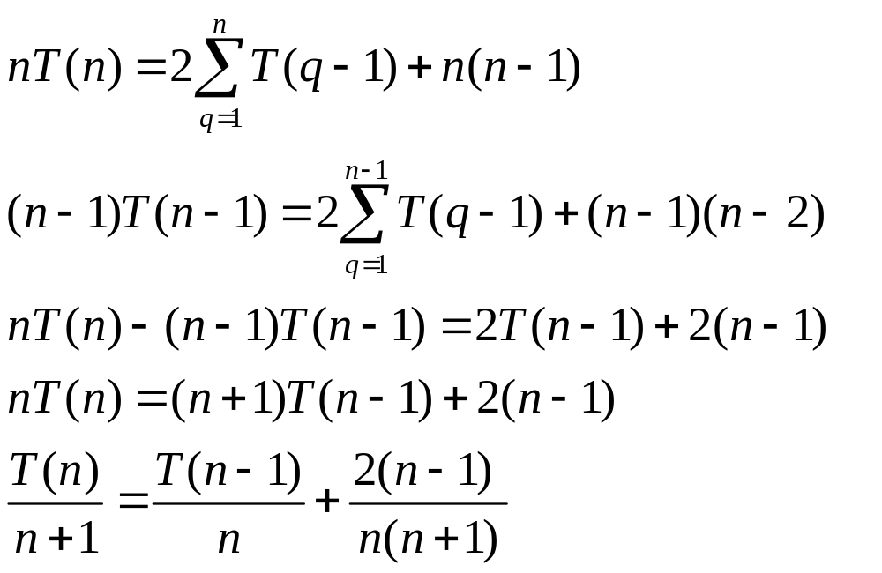
namely

Slide 43
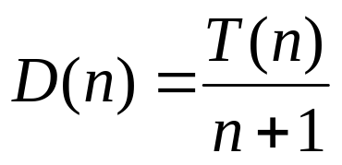
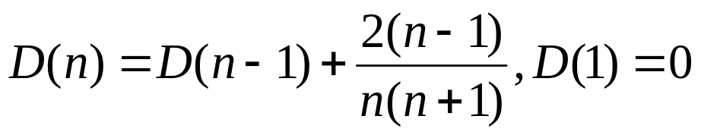
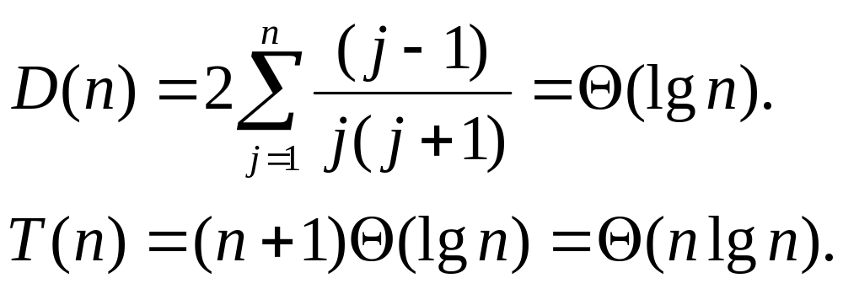
Let

Slide 44
5.4 Integer Multiplication
Problem
Let u and v be two n-bit integers, the problem is to compute the value of uv.
When do we need to multiply two very large numbers?
  In Cryptography and Network Security
  message as numbers
  encryption and decryption need to multiply numbers

Slide 45

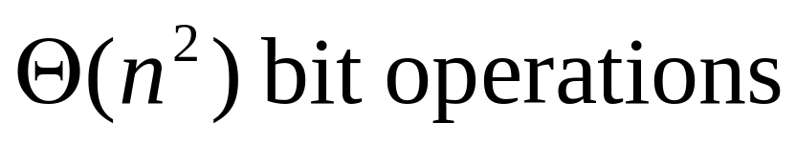
How to multiply 2^{n}-bit numbers
Tradition algorithm:
************
************
************
************
************
************
************
************
************
************
************
************
************
************
************************

Slide 46
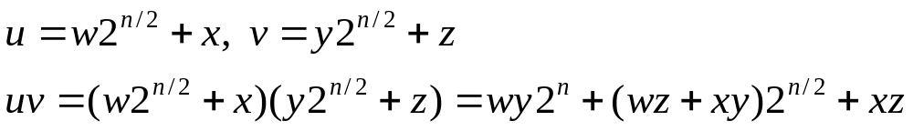
Can We do Better?
Divide and Conquer: Each integer is divided into two parts of n/2 bits each.
u =
w
x
v =
y
z
Note that multiplying by 2^{n} amounts to simply shifting by n bits to the left, which takes Θ(n). Thus there are four multiplications and three additions.

Slide 47

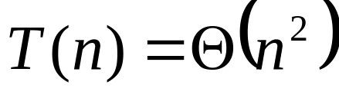
Complexity
By the Master Theorem:

Slide 48
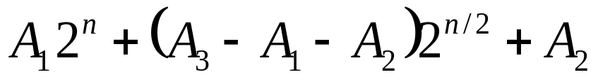
Can we do better?
Now, consider computing wz+xy using the identity
Multiply2int(u,v)
1 if |u| = |v| = 1 then return uv
2 else
3 A₁ = Multiply2int(w,y); A₂ = Multiply2int(x,z)
4 A₃ = Multiply2int(w+x,y+z)
5 return

Slide 49
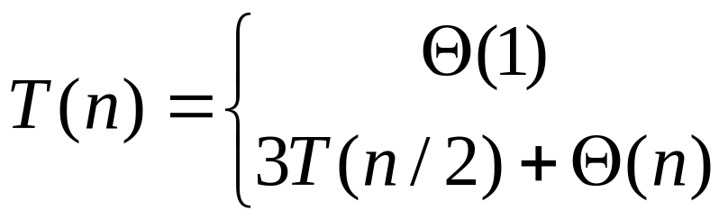
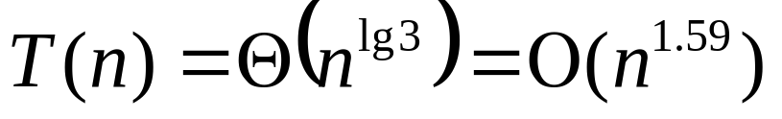
Complexity
The above method yields the following recurrence
if n = 1
if n > 1
By the Master Theorem:

Slide 50
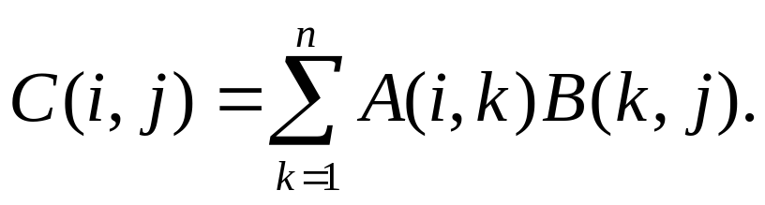
5.5 Matrix Multiplication
Problem:
Given n×n matrices A and B, wish to compute the product C=AB.
Formula for doing this is
This runs in O(n³) time
  In fact, multiplying an n×m by an m×q takes nmq operations

Slide 51
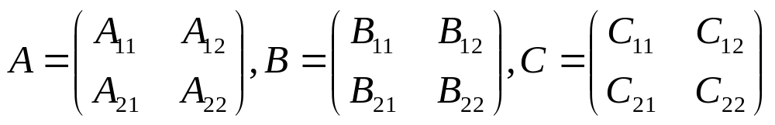
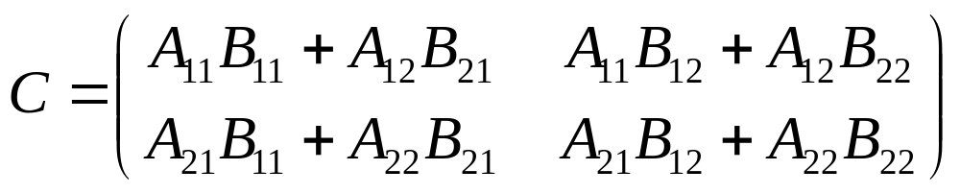
Assume that n=2^{k}, k≥0. If n ≥2, then A,B and C can be partitioned into four matrices of dimensions n/2×n/2 each:
The divide-and-conquer version consists of computing C as defined by the equation

Slide 52
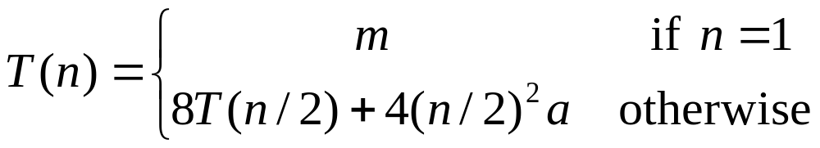
Matrix Multiplication
The cost of multiplying two n×n matrices is thus 8 times the cost of multiplying two n/2× n/2 matrices plus 4 times the cost of adding two n/2×n/2 matrices
Make use of the master method, T(n) is Θ(n³). and thus this method is no faster than the ordinary one.

Slide 53
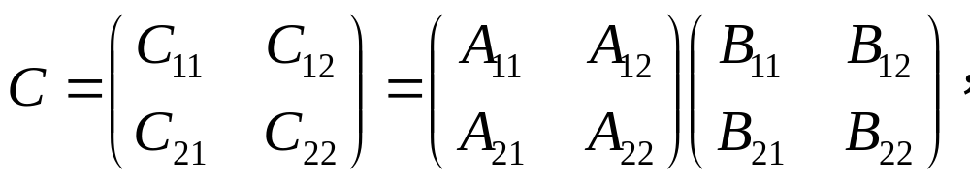
Strassen's algorithm
Strassen's algorithm is to reduce the number of multiplications at the expense of increasing the number of additions and subtractions.
To compute the matrix product
we first compute the following products

Slide 54
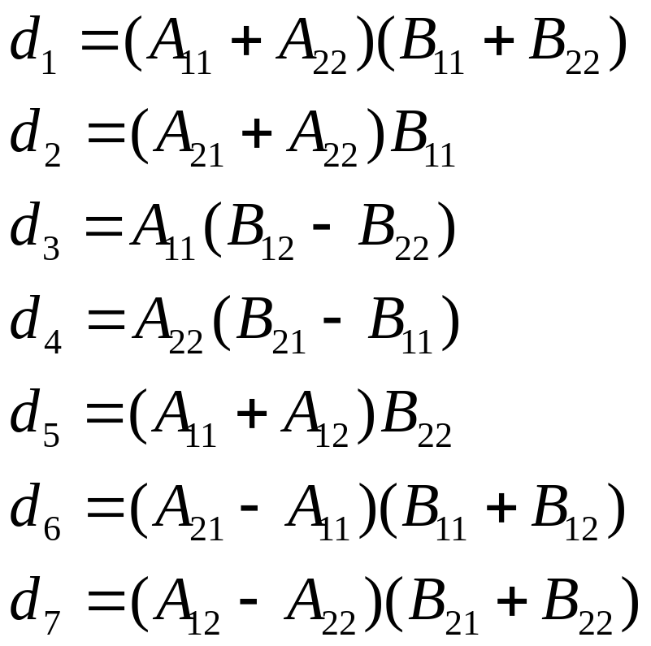
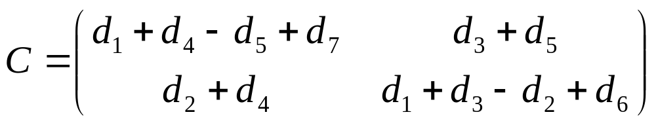

Slide 55
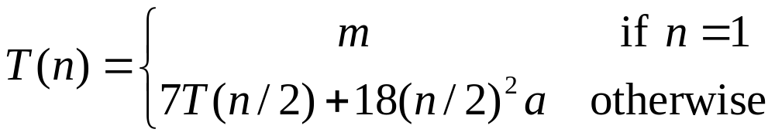
The cost of multiplying two n×n matrices is thus 7 times the cost of multiplying two n/2×n/2 matrices plus 18 times the cost of adding or subtracting two n/2×n/2 matrices
Make use of the master method, T(n) is Θ(n^{lg7})= Θ(n^{2.81}).

Slide 56
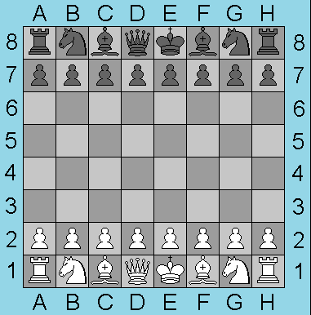
5.6 Tiling a defective chessboard
A real chessboard.

Slide 57
Our definition of a chessboard
A chessboard is an n×n grid, where n is a power of 2.
1×1
2×2
4×4
8×8

Slide 58
Defective chessboard
A defective chessboard is chessboard that has one unavailable (defective) position.
1×1
2×2
4×4
8×8

Slide 59
A triomino
A triomino is an L shaped object that can cover three squares of a chessboard.
A triomino has four orientations.

Slide 60
Tiling a defective chessboard
Place (n² - 1)/3 triominoes on an n×n defective chessboard so that all n² - 1 nondefective positions are covered.
1×1
2×2
4×4
8×8

Slide 61
Tiling a defective chessboard
Divide into four smaller chessboards.
One of these is a defective 4×4 chessboard.

Slide 62
Tiling a defective chessboard
Make the other three 4×4 chessboards defective by placing a triomino at their common corner.
Recursively tile the four defective 4×4 chessboards.

Slide 63
Tiling a defective chessboard
Let array Board denotes chessboard,Board[0][0] denotes the position of left-upper corner, tile denotes the number of triomino，tr denotes the row position of left-upper square in chessboard, tc denotes the column position of left-upper square in chessboard，(dr, dl) denotes the position (row, column) of defective square, size denotes the row or column number of chessboard.

Slide 64
TileBoard(tr, tc, dr, dc, size)
1 if size = 1 return ok
2 tile←tile+1; t ← tile
3 s ← size/2
4 if dr < tr + s and dc < tc + s then
5 TileBoard(tr, tc, dr, dc, s)
6 else Board[tr + s –1, tc + s - 1]←t
7 TileBoard(tr, tc, tr+s-1, tc+s-1, s)
8 if dr < tr + s and dc ≥ tc + s then
9 TileBoard(tr, tc+s, dr, dc, s)
10 else Board[tr + s – 1, tc + s]←t
11 TileBoard(tr, tc+s, tr+s-1, tc+s, s)
12 if dr≥ tr + s and dc < tc + s then
13 TileBoard(tr+s, tc, dr, dc, s)
14 else Board[tr + s, tc + s -1]←t
15 TileBoard(tr+s, tc, tr+s, tc+s-1, s)
16 if dr ≥ tr + s and dc ≥ tc + s then
17 TileBoard(tr+s, tc+s, dr, dc, s)
18 else Board[tr + s, tc + s]←t
19 TileBoard(tr+s, tc+s, tr+s, tc+s, s)

Slide 65
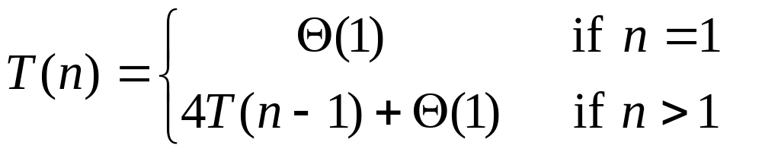
Complexity
Let T(n) be the time taken to tile a 2^{n}×2^{n} defective chessboard.
T(0) = d, where d is a constant.
T(n) = 4T(n-1) + c, when n > 0. Here c is a constant.
Recurrence equation

Slide 66
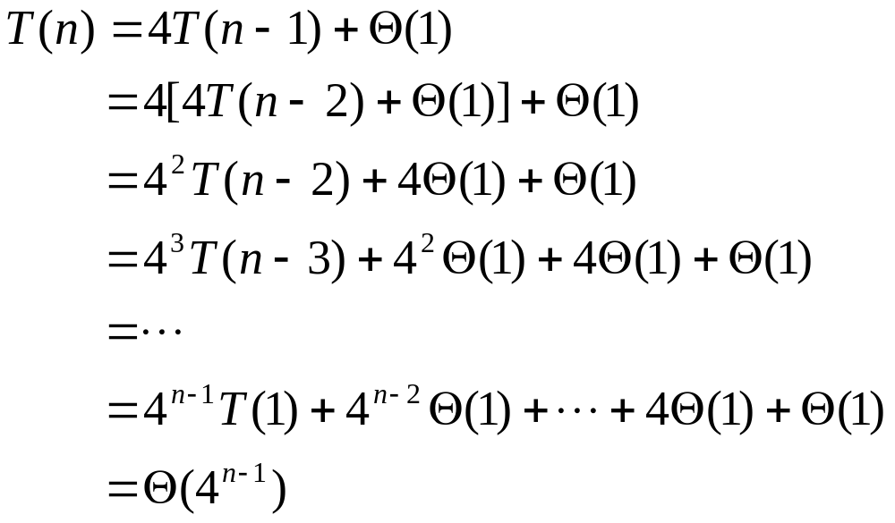
Substitution Method

Slide 67
Homework
Page 63-65
  1.Each group must finish the corresponding exercises
  2.Each group must finish the corresponding experiments

